Slide 1
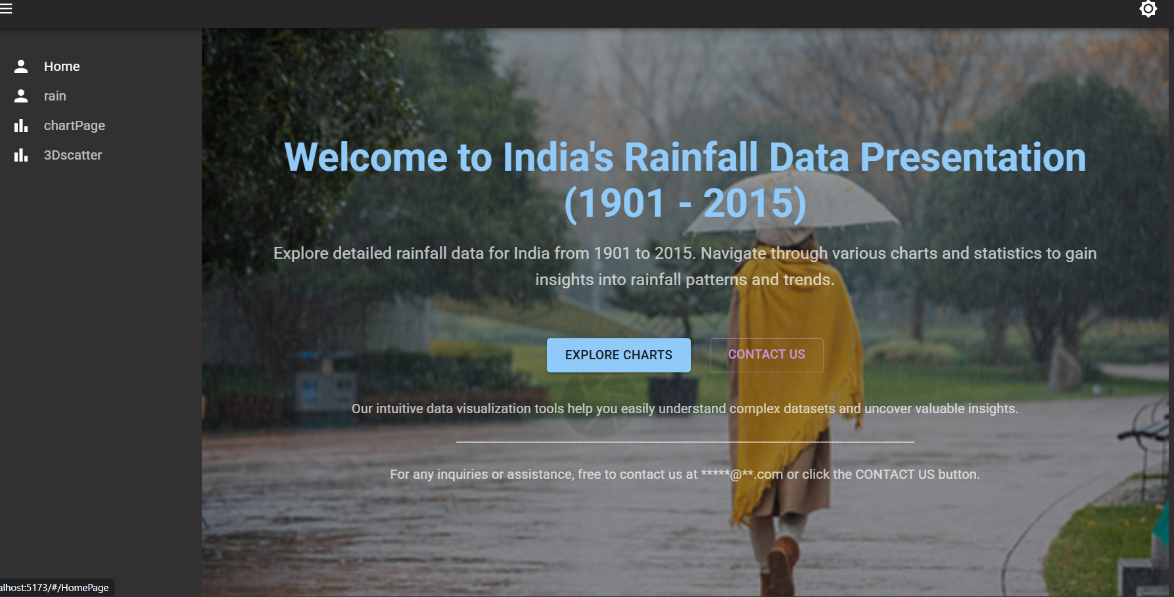

Slide 2
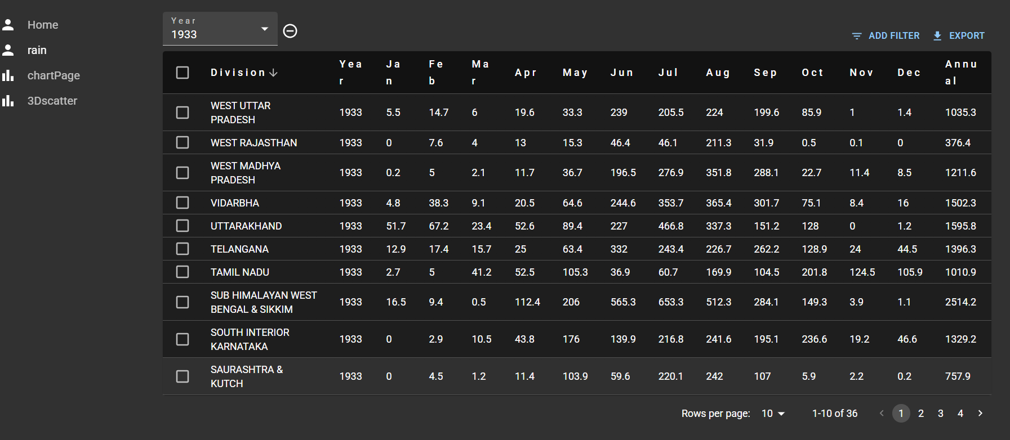

Slide 3
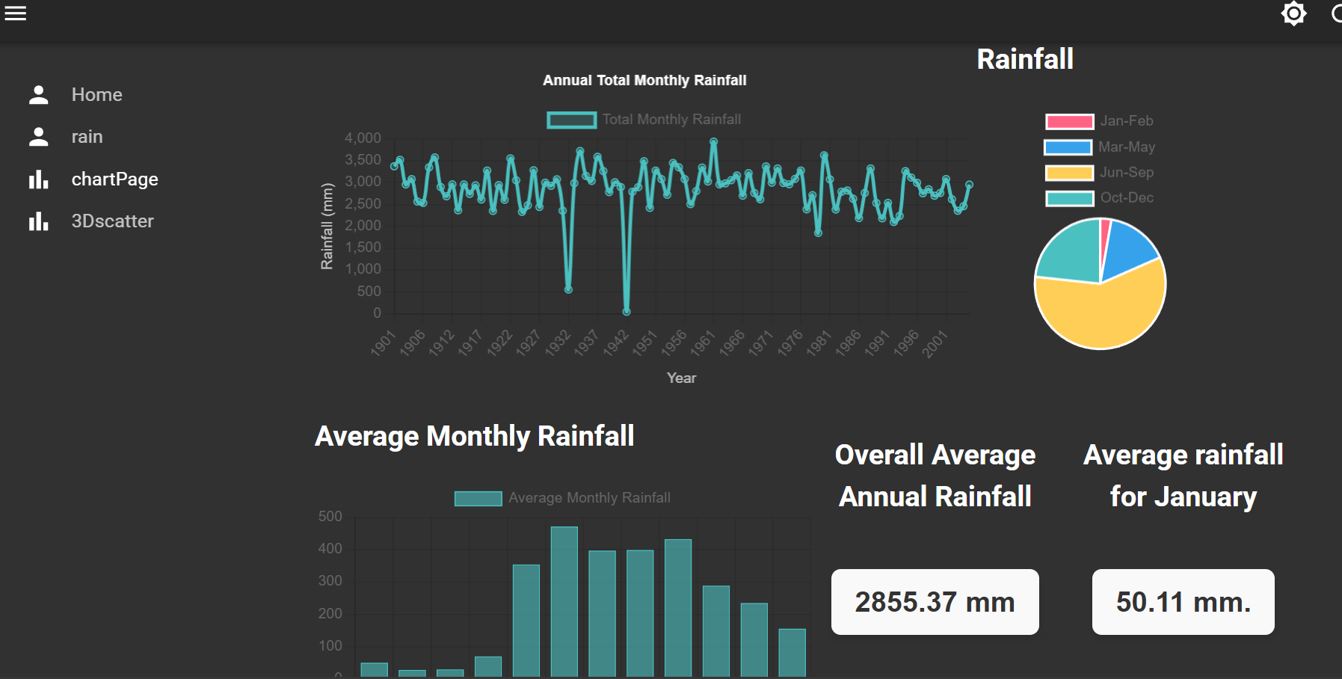

Slide 4
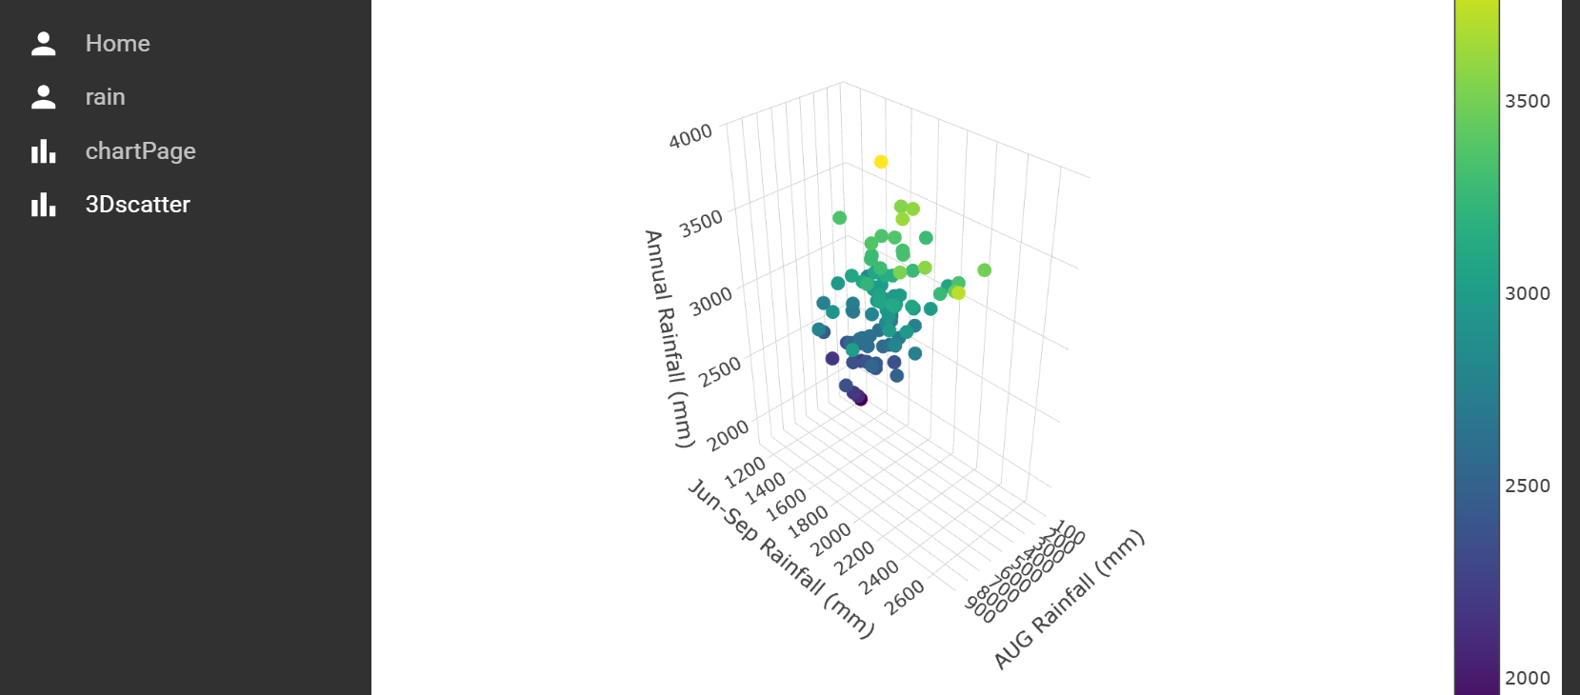

Slide 5















Connections between files 1:how to display pages
App.tsx
CustomMenu.tsx
MyFirstPage.tsx

Slide 6













Connections between files 2:how to get data
filename
Code
rainDataProvider.ts
App.tsx
MyFirstPage.tsx

Slide 7
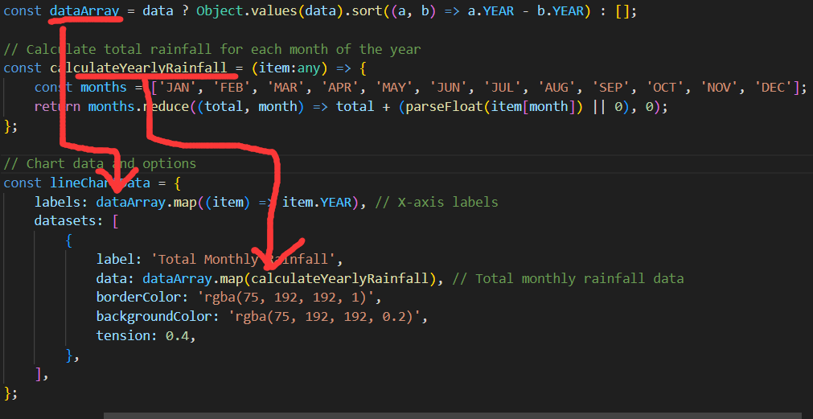
Data processing

Slide 8
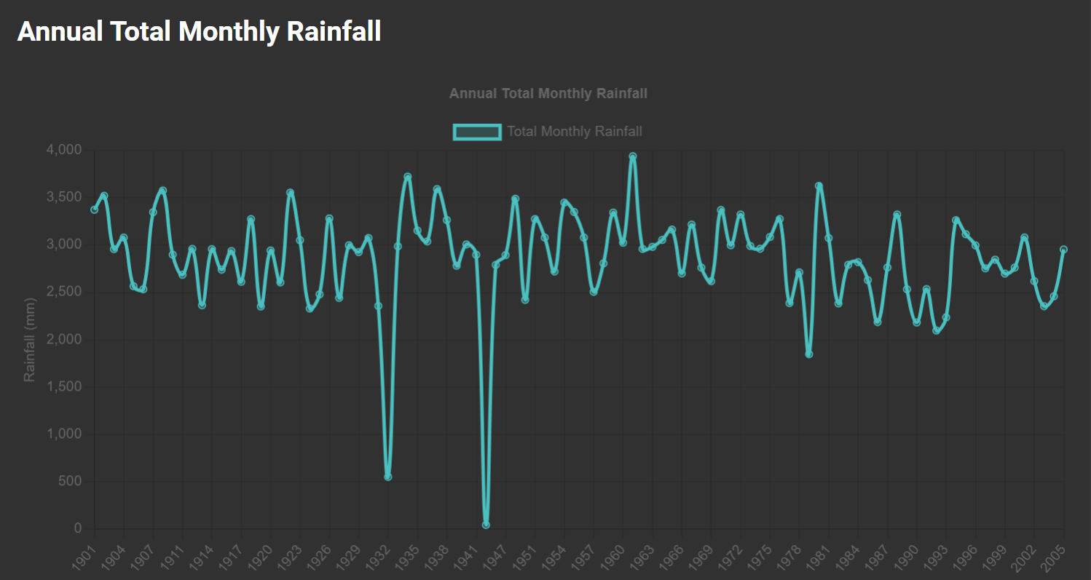
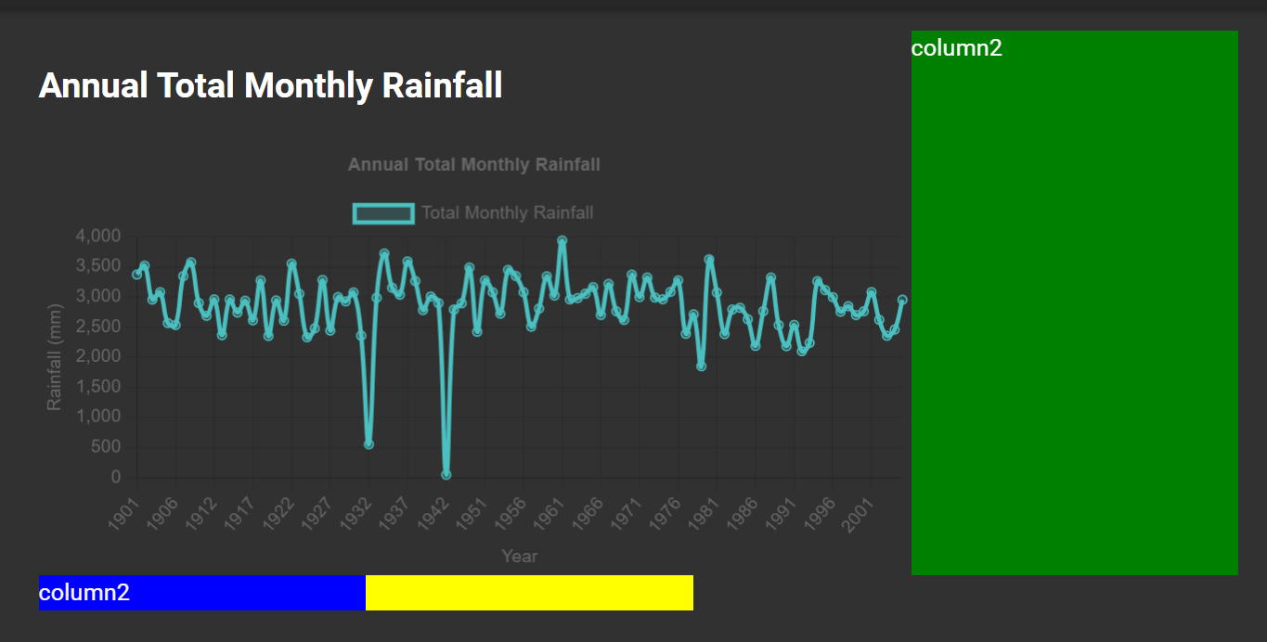

How to display multiple charts on one page

Slide 9
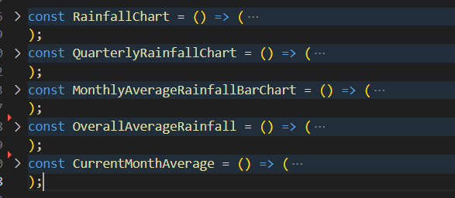
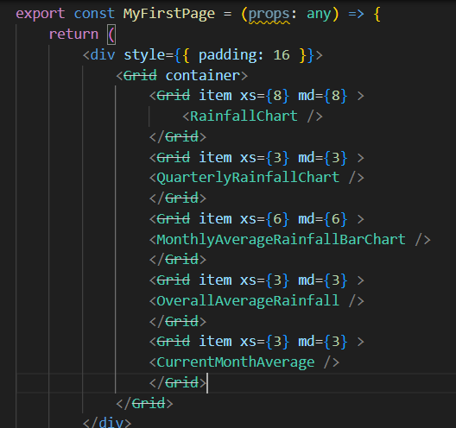







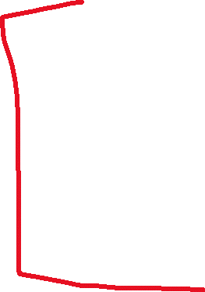

Slide 10
Somethings I didn't do well
1.how to design an Beautiful and effective homepage
2.didn’t use suitable features from reactadmin

